Slide 1

Registration
A responsive webpage on Internet
Ask user to provide basic information
Full Name
Contact Email
Contact Phone Number
Some key questions
Personal information
Full Name
Contact Email
Contact Phone number
Are you Hong Kong Permanent Resident? |  | Yes No
Questions (TBC)
Any medical training in Hong Kong? |  |  | Yes No
Postgraduate medical training experience? | Without Internship Completed Internship Obtained recognizable qualifications comparable to … Obtained specialist qualification by HKAM
CHAN, TAI MAN
tmchan123@abc.com
(852)123456789
Submit

Slide 2

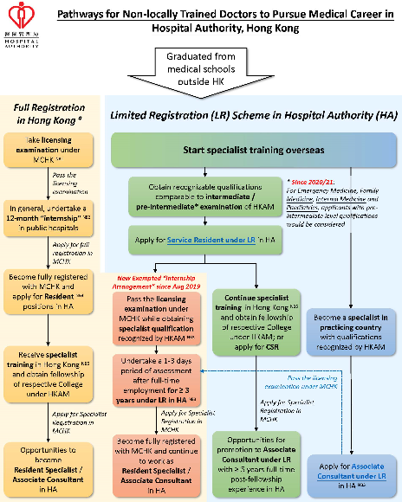

Message after registration
Thank you for your registration.
Show different picture depends on different answer combination to key questions

Slide 3
Project Scope
Provide one responsive webpage on internet
Form information
Personal information
Full name (mandatory) – free text, max. 255 characters
Contact Email (mandatory) – free text, max. 255 characters, in valid email format (with only one “@” char)
Contact Phone number (mandatory) - free text, max. 50 characters
Training and Medical Qualification status (refer to next slide)
Provide button for submission
UI / UX similar to vis.ha.org.hk
After submission of the registration, provide one result page with defined message (Max. 5 different results with given picture that depends on different answer combination to key questions)
Provide technical specification and deployment guide

Slide 4
Training and Medical Qualification status
Question | Answer
Are you Hong Kong permanent resident? | Yes No
Do you have recognized Medical Qualification by Special Registration Committee under MCHK? | Yes No
Do you have any postgraduate medical training experience? | Without Internship Completed Internship Obtained recognizable qualification comparable to intermediate / pre-intermediate examination of HKAM Obtained specialist qualification by HKAM
Which specialty are you interested in? | Accident & Emergency Anaesthesiology Clinical Oncology Emergency Medicine Family Medicine Intensive Care Internal Medicine Obstetrics and Gynaecology Orthpaedics & Traumatology Ophthalmology Otorhinolaryngology Paediatrics Pathology Psychiatry Radiology and Nuclear Medicine Surgical Specialties
Confirm whether you obtained the qualification from the list of endorsed academic authority. | Yes No

Slide 5
Technical requirements
Frontend | ReactJS, Material UI
Backend | Java Springboot, JBoss with open JDK 8
Database | MySQL
Source control | Git
Supported client resolution | 1920 x 1080 or 1280 x 720
Supported client browser | IE 11, IE New Edge, Chrome v91
Supported client OS | Windows and Mac OS

